Slide 1

Lecture 11

Slide 2
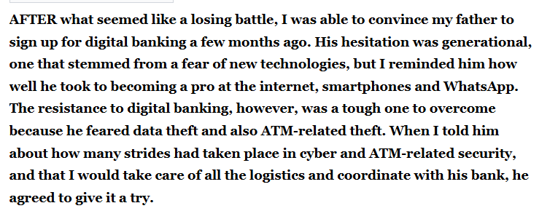

Slide 3
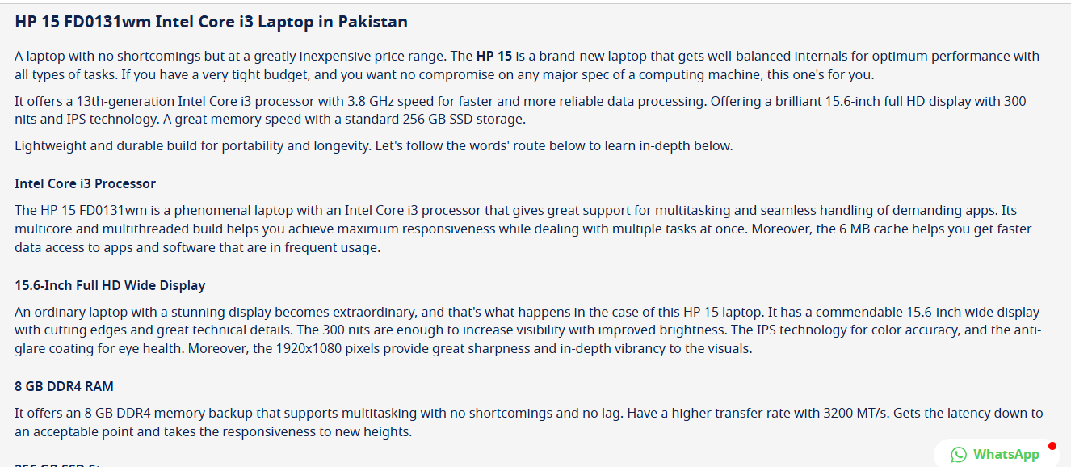

Slide 4
Technical Communication

Slide 5
Practice of conveying complex technical information
Help users to understand and effectively utilize products, services, or processes
Creating content like user manuals, instructions, reports etc.
In a clear, concise, and accessible way to specific audiences
Written or visual formats
Be easily understood by the intended audience

Slide 6
Importance of Technical Communication
Technical communication is the exchange of information that helps people to interact with technology and solve complex problems.
Technical communication helps us interact with technology in our daily lives.
Technical communication helps us solve complex problems.

Slide 7
Technical General
Focus on specific, detailed technical information.
A specialized audience.
Precise language and structured formats.
Involves broader information sharing.
A wider audience.
Personal opinions and feelings.
Using more informal language.

Slide 8
The Challenges of Producing Technical Communication
Audience-related factors
Purpose-related factors
Document-related factors

Slide 9
Main Features of Technical Communication
Reader-Centered
Accessible and Efficient
Often Produced by Teams
Delivered in Paper and Digital Versions

Slide 10
Reader-Centered
Reader-centered documents focus on what people need to learn, do, or decide.
Writing from a reader-centered perspective takes practice and attention.
For example, while the history of how this product was invented may be of interest to the writer, instructions for assembling a new workstation desk should focus on what readers need to do—assemble their desk and start using it.

Slide 11
Analyze Your Document’s Audience and Purpose
Who is the main audience for this document?
Who else is likely to read it?
What is your relationship with the audience?
Are multiple types of relationships involved?
What information does this audience need?

Slide 12
Analyze Your Document’s Audience……..
How familiar might the audience be with technical details?
Do these readers have varying levels of expertise?
What culture or cultures does your audience represent?
How might cultural differences shape readers’ expectations and interpretations?
How will people interact with the material: in digital formats, on paper, or both?

Slide 13
Deciding on a Document’s Level of Technicality

Slide 14
Who will use the document
How much do these readers need
At what level technicality
Expert |  | Just the Facts & Figures
Informal person |  | Facts & Figures Explained
Layperson |  | Facts & Figures Explained in Simplest Terms
Highly Technical
Semi technical
Nontechnical

Slide 15
Accessible and Efficient
Readers expect to find the information they need and to have questions answered clearly.
The content is presented in short chunks, answering the main question readers will ask.
Worthwhile content
Sensible organization
Readable style
Effective visuals
Supplements (abstract, appendix, glossary, linked pages, and so on)

Slide 16
Often Produced by Teams
Technical documents are often complex.
Instead of being produced by a lone writer, complex documents usually are created by teams composed of writers, Web designers, engineers or scientists, managers, legal experts, and other professionals.
The teams might be situated at one site or location or distributed across different job sites, time zones, and countries.

Slide 17
Delivered in Paper and Digital Versions
Technical documents can be delivered in a variety of media such as print (hard copy), Web pages, PDF documents, e-books, podcasts, blog and social media posts, tweets, and online videos.

Slide 18
Purposes of Technical Communication
inform
Instruct
Persuade

Slide 19
Documents That Inform
Informational documents are designed to inform—to provide information that answers readers’ questions clearly and efficiently.
It is designed for a wide audience of readers who may have questions but know little about the technical details.

Slide 20
Documents That Instruct
Instructional documents help people do something: assemble a new computer or to perform CPR.
This page, part of a longer document on energy-efficient heating and cooling, provides basic instructions to help people decide how to choose the most suitable thermostat for their needs.
Action verbs and phrases, such as “think about your schedule” and “decide which of the three models best fits,” are clear and direct.

Slide 21
Documents That Persuade
Motivate your readers.
Persuasion encourages people to take a desired action.
While some documents are explicitly persuasive, even the most technical of documents can have an implicitly persuasive purpose.

Slide 22
Preparing Effective Technical Documents
An Effective Document
Information Delivery
Persuasive Reasoning
Ethical Presentation
Good Teamwork

Slide 23
Deliver information readers can use—because different people in different situations have different information needs.
Use persuasive reasoning—because people often disagree about what the information means and what action should be taken.
Weigh the ethical issues—because unethical communication lacks credibility and could alienate readers.
Practice good teamwork—in most professions, documents are not produced by one person but by a team of colleagues from different parts of the organization.

Slide 24
Principles of Technical Writing
Clarity
Conciseness
Accuracy
Comprehensiveness
Accessibility
Correctness
Professional appearance

Slide 25
Clarity
Avoiding ambiguity and jargon.
Your goal is to produce a document that conveys a single meaning the reader can understand easily. An unclear technical document can be dangerous.
In addition, an unclear technical document is expensive.

Slide 26
Conciseness
Eliminating unnecessary words.
A document must be concise enough to be useful to a busy reader.
You can shorten most writing by 10 to 20 percent simply by eliminating unnecessary phrases, choosing shorter words, and using economical grammatical forms.
Your job is to figure out how to convey a lot of information economically.

Slide 27
Accuracy
Ensuring factual correctness
A slight inaccuracy can confuse and annoy your readers; a major inaccuracy can be dangerous and expensive.
In another sense, accuracy is a question of ethics.
Technical documents must be as objective and unbiased as you can make them.
If readers suspect that you are slanting information—by overstating or omitting facts—they will doubt the validity of the entire document.

Slide 28
Comprehensiveness
A good technical document provides all the information readers need.
It describes the background so that readers unfamiliar with the subject can understand it.
It contains sufficient detail so that readers can follow the discussion and carry out any required tasks.

Slide 29
Accessibility
Most technical documents are made up of small, independent sections.
Because few people will read a document from the beginning to the end, your job is to make its various parts accessible.
That is, readers should not be forced to flip through the pages or click links unnecessarily to find the appropriate section.

Slide 30
Correctness
Correctness is a core principle of technical communication that means ensuring a message is factually accurate, grammatically sound, and free of spelling errors.
This principle also requires using the appropriate level of language for the audience and checking the accuracy of figures, names, and job titles.
Maintaining correctness builds the sender's credibility, while errors can undermine the message's reliability and the author's authority.

Slide 31
Professional appearance
You start to communicate before anyone reads the first word of the document.
If the document looks neat and professional, readers will form a positive impression of it and of you.
Your document should adhere to the format standards of your organization or your professional field, and it should be well designed.

Slide 32
What is Technical Writing
Involving special knowledge, language, etc., that is used or understood by experts but usually not by others
Relating to the knowledge, machines or methods used in science and industry.
Technical writing communicates specific and factual information to a defined audience for a defined purpose.

Slide 33
“Technical writing conveys specific information about a technical subject to a specific audience for a specific purpose… The words and graphics of technical writing are meant to be practical: that is, to communicate a body of factual information that will help an audience understand a subject or carry out a task.”
-Michael H. Markel

